Slide 1

German Credit Risk Analysis
MS Power BI Analysis Dashboard “Story Telling”

Slide 2

EDA:Exploratory Data Analysis
We would use EDA stands for Exploratory Data Analysis. It's an approach to analyzing and summarizing data in order to understand its key characteristics and relationships.

Slide 3

Analysis steps
Import the German Credit Risk dataset into Power BI. Get Data from csv file.
Clean Data by using MS Power Editor to clean Data and Transform them by Removing Blank values, and so on
Create Charts such as Line , Pie, Donut, Tables, Matrix, and using DrillThrough techniques to move to details, and we would use "Visualizations" pane to select the type of visualization we want to create..
Apply filters and Slicers to visualizations to isolate specific segments of the data. For example, we filterd by credit risk category, age range, or employment status.
Use the "Analytics" pane to add statistical measures to your visualizations. For example, you can add a trend line to a scatter plot or a box plot to show the distribution of credit risk by income level.
Create a dashboard to present analysis. The dashboard should include multiple visualizations that provide a comprehensive overview of the data.

Slide 4
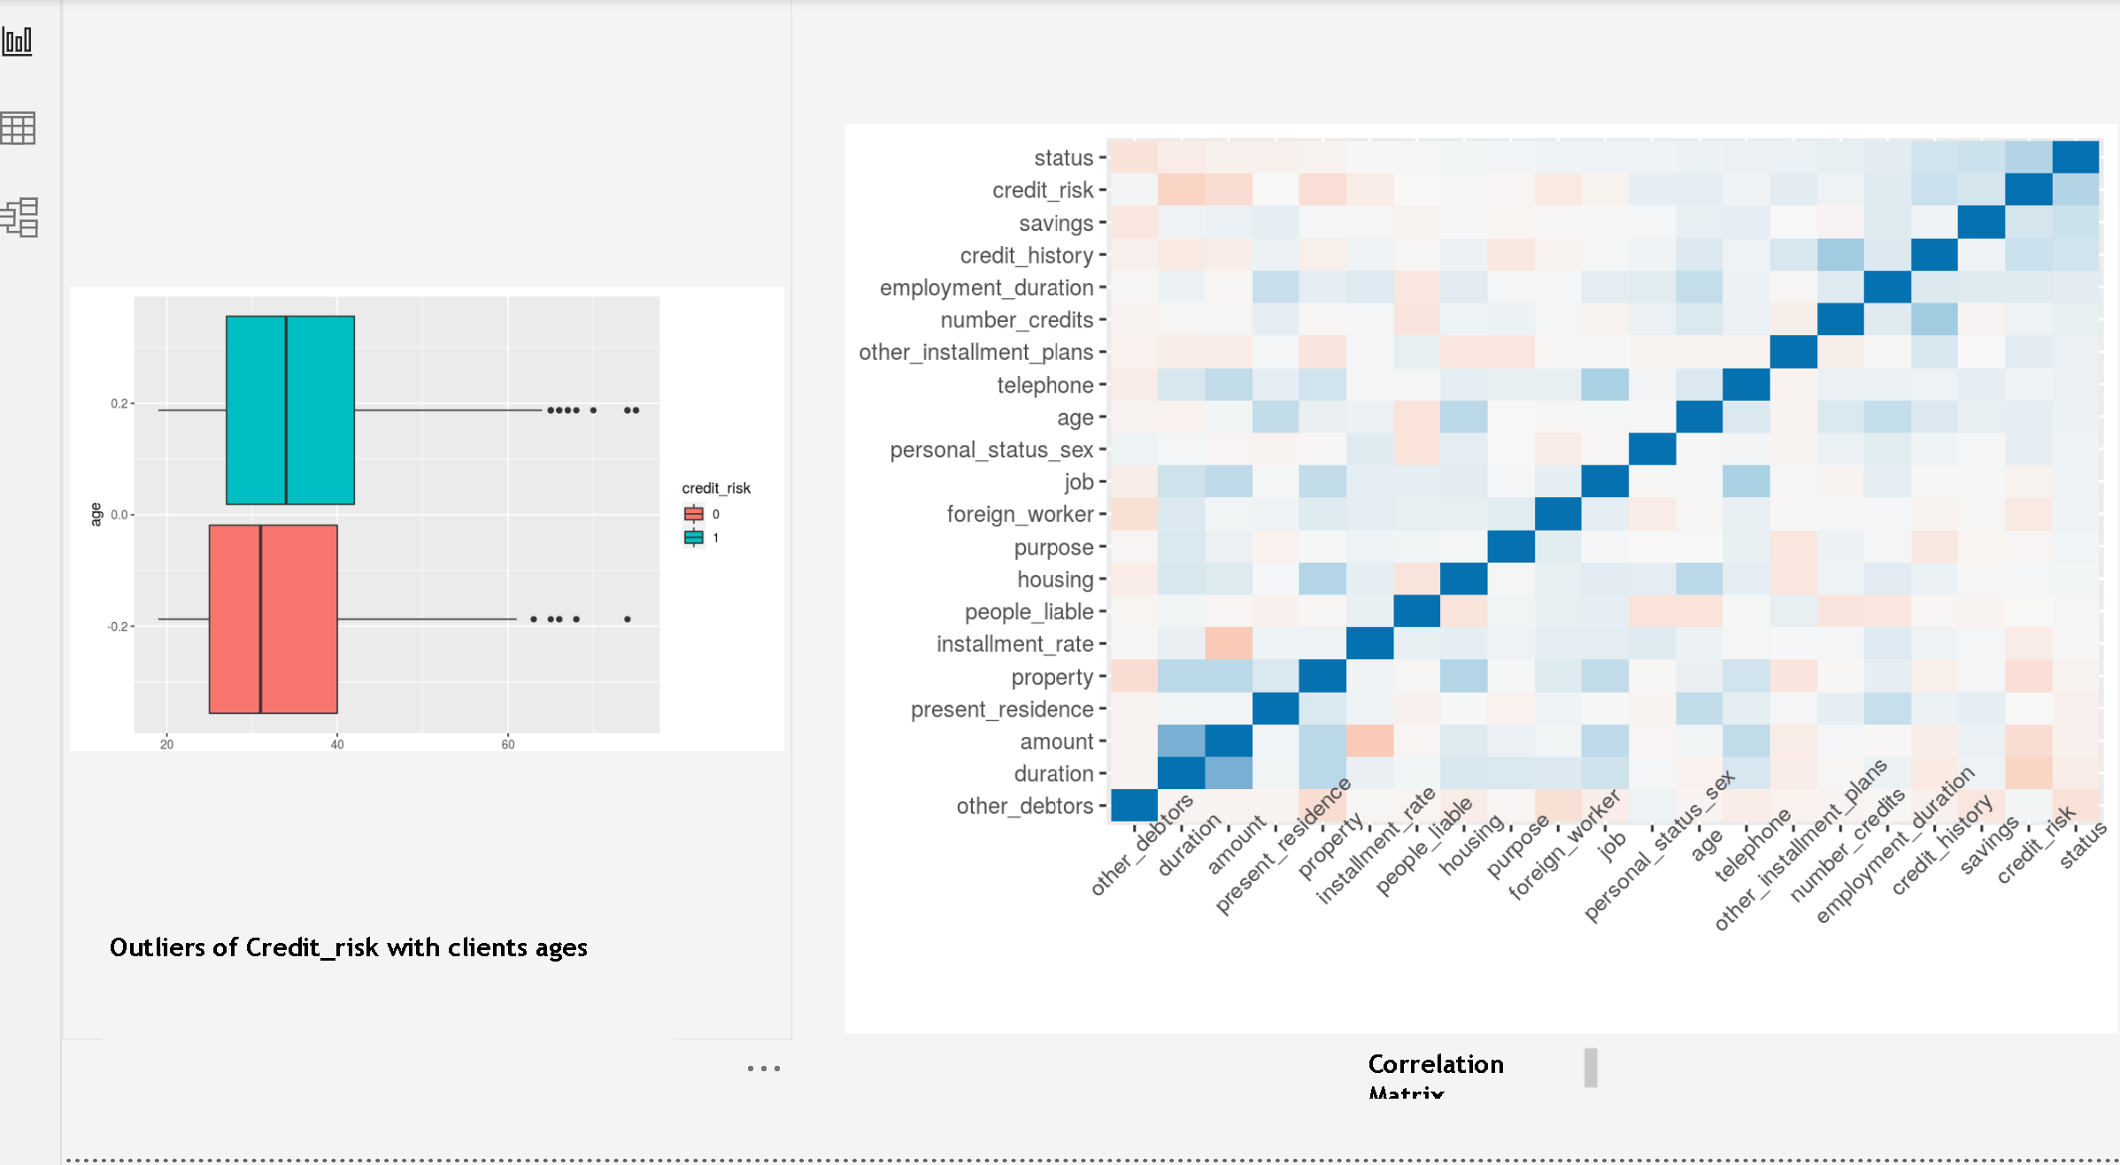

Slide 5
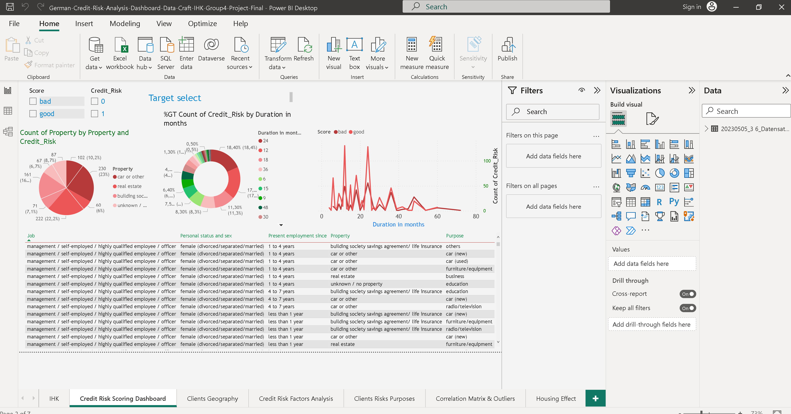

Slide 6
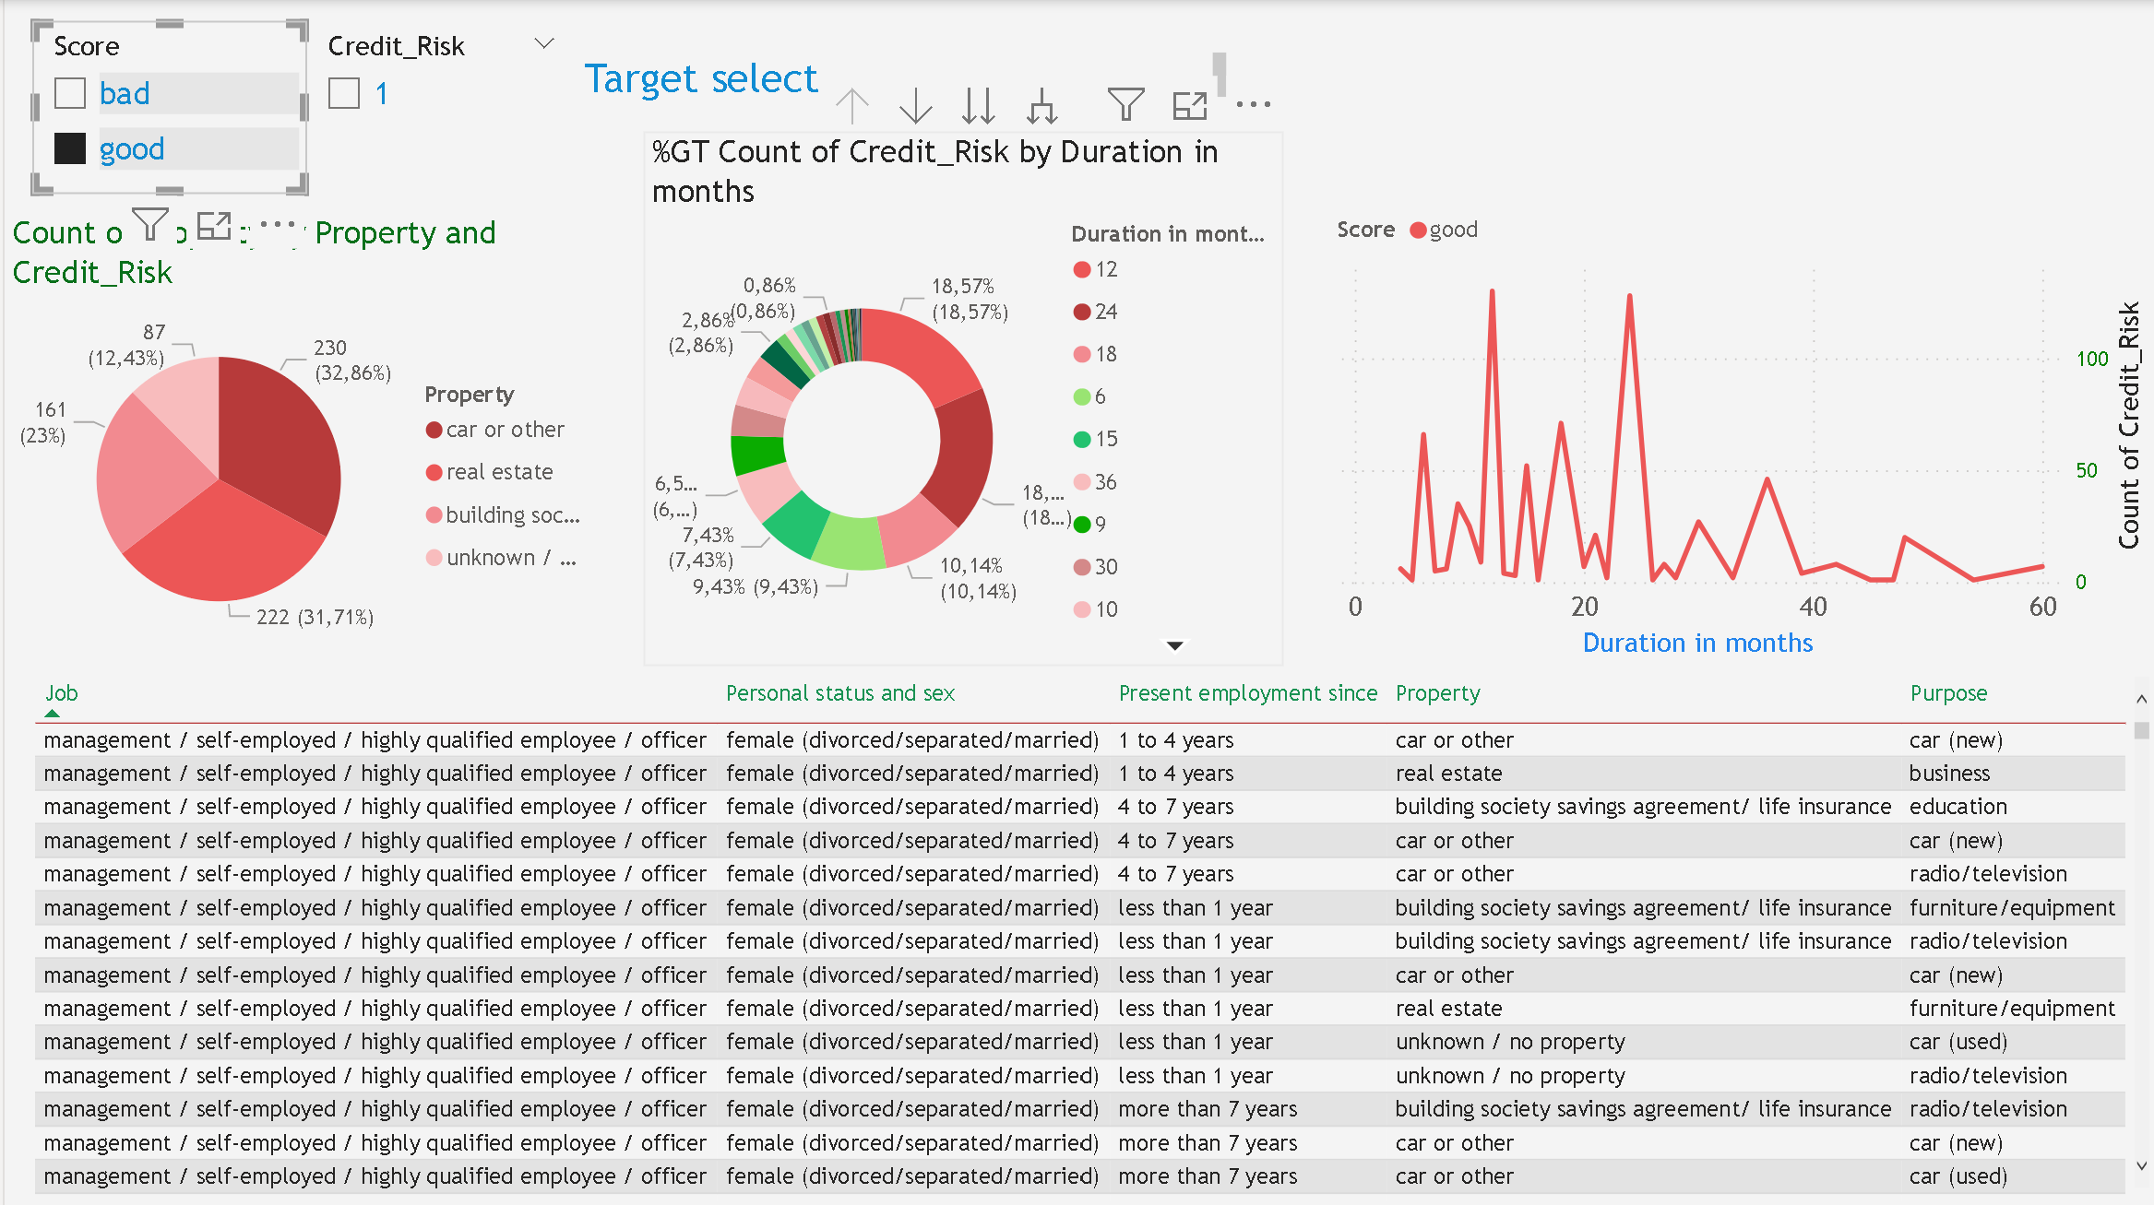

Slide 7
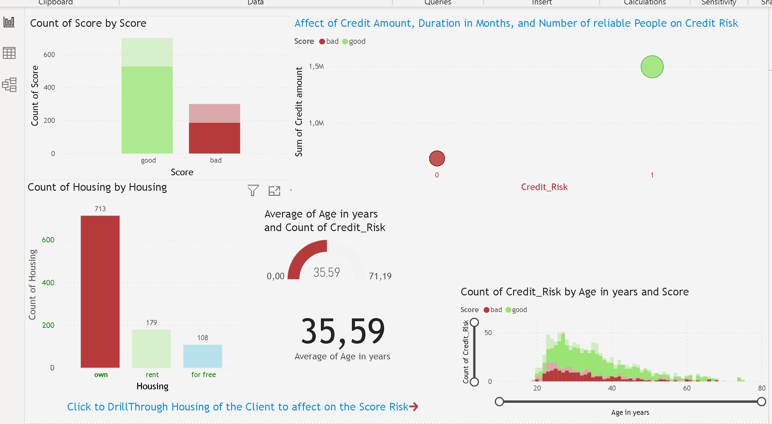

Slide 8
